Slide 1

Blockchain Powered Parking Solution for Smart Cities
Capstone A (Presentation)
Dept. Of Computer Science and Engineering
Presented by :
Fahamidul Hasan (2018-3-60-089)
Adnan Rahman Tushar (2019-3-60-099)
Sihama Ramjana Khadija (2020-1-60-019)
Tanjela Rahman Rosni (2020-1-60-018)
Supervisor :
Md Mostofa Kamal Rasel

Slide 2
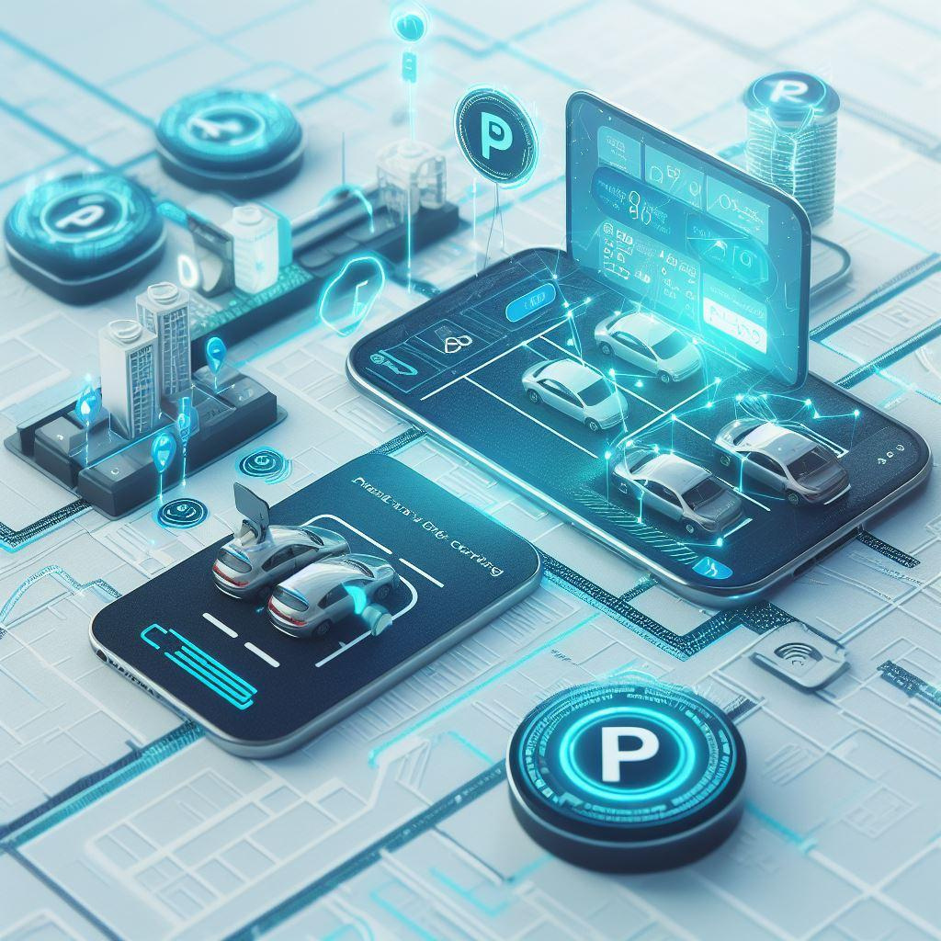
Introduction and Background
In this Presentation, we will cover the process of efficiently handling monetization of urban parking management using modern technologies.
Modern technology based automated parking management in urban areas.
Real-Time Availability Tracking
Peer-to-Peer (P2P) Parking Sharing
Integration with Navigation Apps
Secure Decentralized Environment
Monetization difficulties for Urban parking management:
Trust and security concerns
Legal and liability issues
Pricing and visibility
Marketing and promotion
Maintenance and upkeep
Payment processing

Slide 3

A Blockchain-based solution for creating smart parking spaces
Contribution and Services:
Blockchain-based ecosystem
Implementation of non-fungible parking tokens (NFT’s)
Utilization of smart contracts
Real-time surveillance
User-friendly mobile application for finding, booking, and paying for parking spaces.
Inefficiencies:
Privacy Concerns
Security Deposit
Stakeholders:
The certified owners of the land.
The contractors
Government Agencies
Rental packages:
Hourly
Daily
Monthly
Individuals and companies are targeted.
It does not go into specific technical details on how the searching/recommendation system for available parking spaces is implemented. It only provides a high-level overview of the system's functionality
Related Work [1]
[1] H.S. Jennath et al. “Parkchain: A blockchain powered parking solution for Smart Cities,” Frontiers, vol. 2,2023

Slide 4
An Ethereum-based consortium blockchain parking system
Contribution and Services:
Consortium Blockchain
Privacy-Preserving Parking Management
Smart Contracts for Rental
User Anonymity
Inefficiencies:
Storage of all data in the blockchain
User Adoption
Stakeholders:
Vehicle users(drivers)
Parking space owners
Government departments
Certification authority
Blockchain developers
Service provider
Rental Packages:
Hourly
Daily
Monthly
Flexible duration
Dynamic pricing
Individuals and companies are targeted
The specific technical details of implementation searching are not provided in the article.Also, recommendation algorithm is not detailed , it is likely designed to match user preferences with available parking spaces while considering user privacy and security.
Related Work [2]
Parking Management
J. Hu, D. He, Q. Zhao and K. -K. R. Choo, "Parking Management: A Blockchain-Based Privacy-Preserving System," in IEEE Consumer Electronics Magazine,2019

Slide 5
An integrated smart parking system that leverages blockchain technology to address the challenges related to trust and data integrity in a smart city.
Contribution and Services:
Scalability (Layered architecture)
Seamless User Experience
Inefficiencies:
High Transaction Costs (Gas Fee)
Stakeholders:
Individual Clients
Commercial Users (Enterprises)
Owners/Operators of Parking Garages
Developers of blockchain
Local Authorities
Data Analytics and Insights
Lend parking place for:
Hourly rentals
Daily rentals
Monthly rentals
Custom durations
Individuals and companies are targeted
The specific technical details of implementation/recommendation searching for parking spaces are not declared here properly. But it involves the integration of various sensors, data processing, user interfaces, APIs and real-time data analysis to provide accurate and up-to-date information to drivers.
Related Work [3]
A Blockchain based architecture for integrated smart parking
S. Ahmed, Soaibuzzaman, M. S. Rahman and M. S. Rahaman, "A Blockchain-Based Architecture for Integrated Smart Parking Systems," 2019 IEEE International Conference on Pervasive Computing and Communications Workshops (PerCom Workshops), Kyoto, Japan, 2019

Slide 6
An integrated smart parking system that leverages blockchain technology to address the challenges related to trust and data integrity in a smart city.
Contribution and Services:
Privacy Protection (Cryptographic Techniques)
Fairness (Honest miners are rewarded while dishonest are penalized)
Efficiency (Constant time complexity for most operations)
Parking Operations Handling
Inefficiencies:
Computation Overhead
Complex registration and Payment procedures
Stakeholders:
Payment Service Providers
Network Operators
Sensors Providers
Parking Facility Owners
Local Governments
personal vehicles users
Lend parking place for:
specific durations
Annually rentals
Semi-Annually renters
Quarterly rentals
Daily, hourly, weekly, monthly renters
Individuals and companies are targeted
The specific technical details of implementation searching are not provided clearly but included fair allocation algorithms which consider the user factors. Also, recommendation system provides users accurate and real-time information for considering the overall parking experience.
Related Work [4]
BSFP: Blockchain-Enabled Smart Parking
C. Zhang et al., "BSFP: Blockchain-Enabled Smart Parking With Fairness, Reliability and Privacy Protection," in IEEE Transactions on Vehicular Technology, vol. 69, June 2020

Slide 7
An integrated smart parking system that leverages blockchain technology to address the challenges related to trust and data integrity in a smart city.
Contribution and Services:
Privacy-Preserving Smart Parking (Anonymous)
Reputation Management
Fair Parking Rates
Inefficiencies:
Blockchain Overheads
Accuracy of reputations
User Learning Curve
Stakeholders :
Drivers
Parking Lots
Parking Authority
Parking Packages:
Hourly
Daily
Monthly
Individuals are targeted
Related Work [5]
Smart Parking System With Privacy Preservation and Reputation Management Using Blockchain
M. M. Badr, W. A. Amiri, M. M. Fouda, M. M. E. A. Mahmoud, A. J. Aljohani and W. Alasmary, "Smart Parking System With Privacy Preservation and Reputation Management Using Blockchain," in IEEE Access, vol. 8, pp. 150823-150843, 2020

Slide 8
Recommendation For Parking Space :
Offer submission :
Parking lots submit parking offers to the consortium blockchain
Offers include location, capacity, rate, and commitment value
Commitment value ensures fair pricing
Offer retrieval :
Drivers query the blockchain for matching parking offers
Drivers' preferences include distance, price, or reputation
Private information retrieval technique protects drivers' location privacy
M. M. Badr, W. A. Amiri, M. M. Fouda, M. M. E. A. Mahmoud, A. J. Aljohani and W. Alasmary, "Smart Parking System With Privacy Preservation and Reputation Management Using Blockchain," in IEEE Access, vol. 8, pp. 150823-150843, 2020

Slide 9
Now we are going to discuss some of the common properties and gaps regarding all of the related works mentioned.
Common Properties:
Privacy-Preserving Smart Parking (Anonymous)
Reputation Management
Fair Parking Rates
Gaps:
Blockchain Overheads
Accuracy of reputations
User Learning Curve
Discussion

Slide 10

Research Questions
Main Question:
How to monetize and best utilize an empty parking spot owned by and individual or a group to reduce the street parking ?
Sub-Questions:
How to facilitate empty parking spot for renting ?
How to manage monetization of a parking spot ?
How to find the best parking spot in terms of easy accessibility, facilities, and lower cost ?
How to maintain security of parking spot, cars and transactions ?
How to reduce cost of maintenance, transactions, and resources ?
These questions guide our exploration of blockchain's potential in parking management.

Slide 11
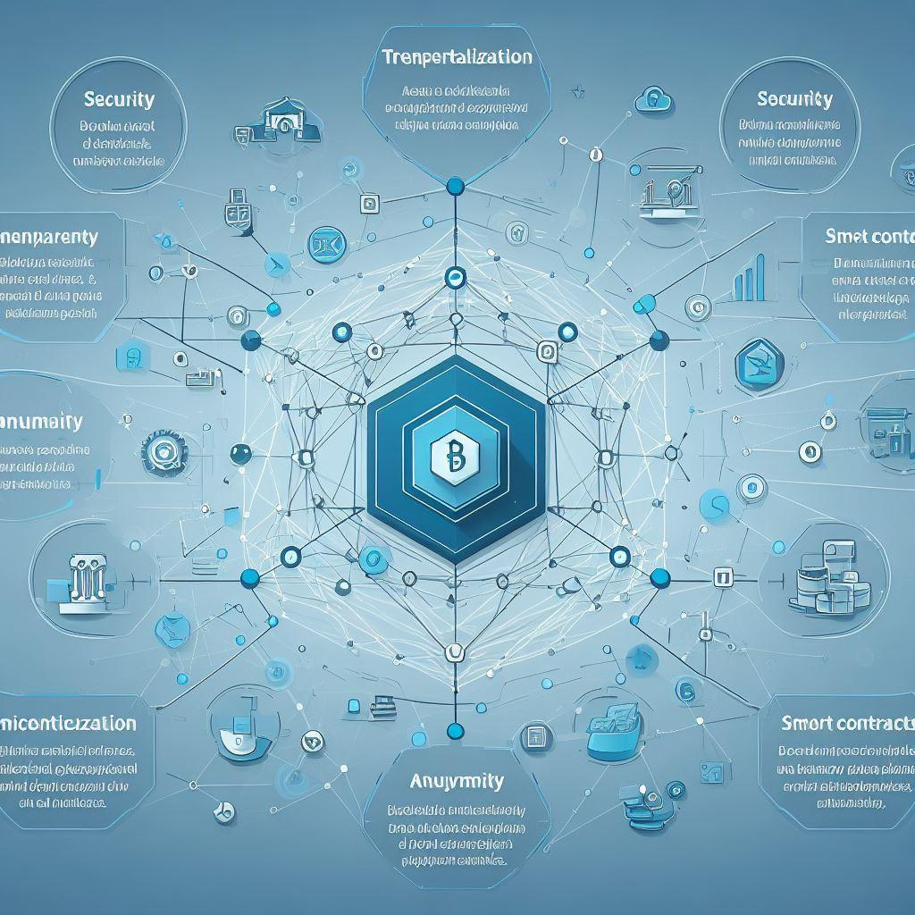
Objectives
Research Objectives:
Our aim is to monetize and best utilize an empty parking spot owned by an individual or group to reduce the street parking.
Implement user authentication and authorization for access to parking services.
Monetization of parking spot using digital payment system.
Parking spot recommendation based on ease of accessibility, facilities and cost efficiency.
leverage blockchain to track and trace transactions and maintain security of parking spot and cars.
Reduce maintenance cost and optimize transactions and resources (Blockchain + DB)

Slide 12

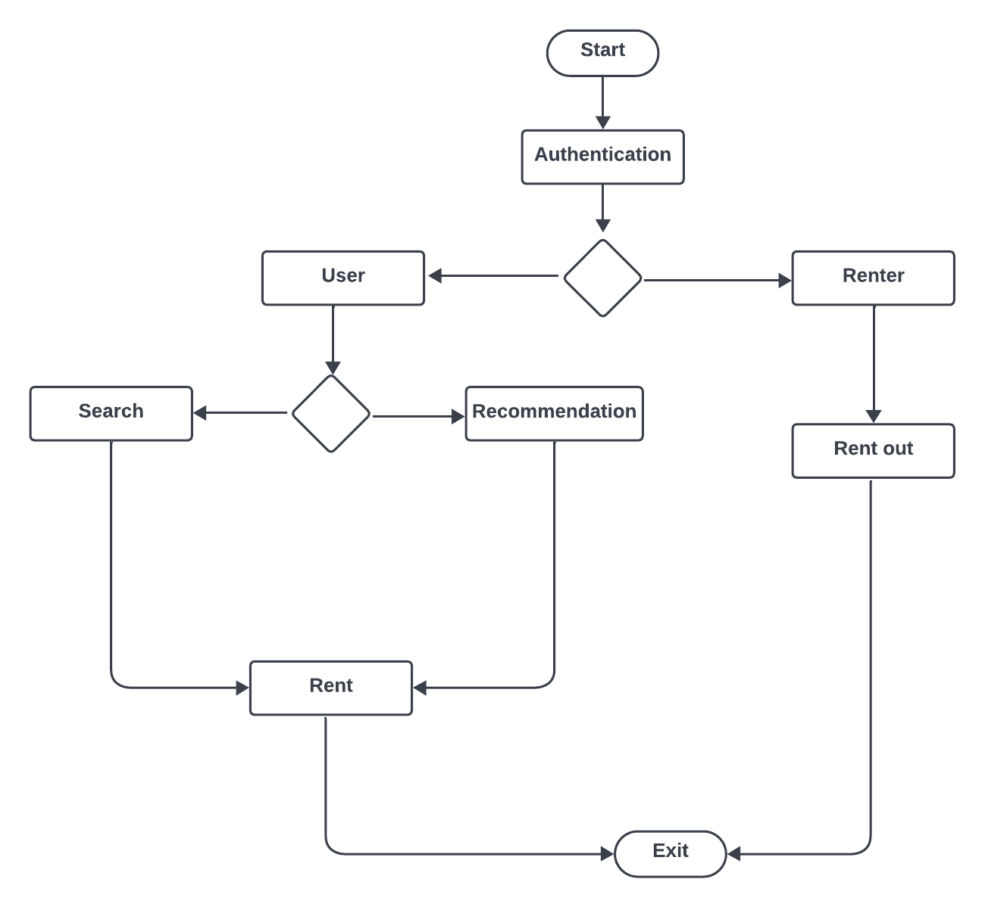
Planned Methodology

Slide 13

Data Analysis
Data Collection:
Geographical locations of parking facilities will be obtained through Google Maps API.
Expected Outcome:
Generate parking recommendations based on analyzed data.
Data analysis will ensure an enhanced user experience.

Slide 14

Expected Results
Final Product:
A user-friendly blockchain-based parking system.
Outcomes:
Improved efficiency and reduced waiting times.
Enhanced security in parking transactions.
Reduction in fraudulent activities related to parking.
Streamlined payment processes with the use of smart contracts.
Enhanced user experiences, leading to higher satisfaction.
We anticipate these outcomes will demonstrate the value and potential of blockchain in transforming parking management.

Slide 15

Conclusion
Enhance parking management.
User-friendly and trust-worthy.
Address current challenges.
Shape the future of urban parking.

Slide 16

Appendix
CO | Knowledge Profile(K) | Complex Engineering Problem (EP)
CO1) Creating user-friendly Interfaces for drivers to find and pay for parking spots and blockchain guarantees secure and transparent transactions, aided by smart contracts for automated payments and enhanced user trust. | (i) Background [K1, K2, K3] : (K1) : Monetizing a blockchain-based parking system combines technology, economics, and data analysis for success. The system relies on blockchain's decentralization and immutability, using cryptography and consensus for security and transparency. (K2) : Algebra and Discrete Math for smart contracts, Statistics for data insights, and Formal Software Engineering for reliability. (K3) : Engineering basics, blockchain knowledge, cybersecurity, IoT integration, economics, and user-centric design are fundamental for monetizing a blockchain-based parking system. | (i) Background [EP1] : Deep blockchain understanding is crucial, encompassing data structure, consensus, cryptography, and decentralized ledgers.[K3] , Specialized engineering knowledge includes blockchain, cybersecurity, IoT, data analytics, Smart Contract Development, UX Design [K4,K5] Ensuring data security, transparency, trustworthiness, and economic impact analysis [K7]. Engagement with research literature involves learning from existing knowledge, sharing findings, and staying updated with the latest research[K8]. (ii) Research Questions/Problem Statements [EP6] : Maximizing revenue from privately owned parking spots to alleviate street parking congestion.

Slide 17
CO | Knowledge Profile(K) | Complex Engineering Problem (EP)
CO2) Examined updated blockchain based literatures to define the problems and formulate the objectives for this project. | (i) Related Works [K8] : Papers on blockchain based car parking management systems and smart contracts. | (i) Related Works [EP1] : Evaluate research papers for adherence to engineering fundamentals, including sound theory, methodology, data analysis, ethics, and practical applicability.[K3,K4,K6,K7,K8]. (ii) Objectives [EP2, EP6, EP7] : EP2 : Involves balancing privacy and transparency, scalability and decentralization, regulatory compliance, and user adoption with security, among other technical and engineering challenges. EP6 : Diverse stakeholders, from drivers , Parking Lot Owners and Operators, governments to technology providers and environmental advocates, have varying needs in blockchain-based parking management. EP7 : Blockchain Infrastructure is a high level problem and smart contracts with data privacy and security are the sub problems

Slide 18
CO | Knowledge Profile(K) | Complex Engineering Problem (EP)
CO2) Examined updated blockchain based literatures to define the problems and formulate the objectives for this project. | (i) Related Works [K8] : Papers on blockchain based car parking management systems and smart contracts. | (ii) Planned Methodology [EP2, EP6] : EP2 : Assessment, interdisciplinary collaboration, ethical considerations, user-centered design, scalability, data security, and continuous improvement. EP6 : Stakeholder engagement, assessment, ethical framework, user-centered design, and adaptability.

Slide 19
References
[1] S. Jennath et al.,S.Adarsh,Nikhil V.Chandran,R.Ananthan,A.Sabir and S.Asharaf “Parkchain: A blockchain powered parking solution for Smart Cities,” Frontiers, vol. 2,2023, doi:10.3389/fbloc.2019.00006
[2] J. Hu, D. He, Q. Zhao and K. -K. R. Choo, "Parking Management: A Blockchain-Based Privacy-Preserving System," in IEEE Consumer Electronics Magazine, vol. 8, no. 4, pp. 45-49, July 2019, doi: 10.1109/MCE.2019.2905490.
[3] S. Ahmed, Soaibuzzaman, M. S. Rahman and M. S. Rahaman, "A Blockchain-Based Architecture for Integrated Smart Parking Systems," 2019 IEEE International Conference on Pervasive Computing and Communications Workshops (PerCom Workshops), Kyoto, Japan, 2019, pp. 177-182, doi: 10.1109/PERCOMW.2019.8730772.
[4] C. Zhang et al., "BSFP: Blockchain-Enabled Smart Parking With Fairness, Reliability and Privacy Protection," in IEEE Transactions on Vehicular Technology, vol. 69, no. 6, pp. 6578-6591, June 2020, doi: 10.1109/TVT.2020.2984621
[5] 1.M. M. Badr, W. A. Amiri, M. M. Fouda, M. M. E. A. Mahmoud, A. J. Aljohani and W. Alasmary, "Smart Parking System With Privacy Preservation and Reputation Management Using Blockchain," in IEEE Access, vol. 8, pp. 150823-150843, 2020, doi: 10.1109/ACCESS.2020.3016945.
[6] M.Ibrahim, Y. Lee, H.-K. Kahng, S. Kim, and D.-H. Kim, “Blockchain-based parking sharing service for smart city development,” in IEEE Access,vol. 103,ISSN 0045-7906,2022,doi:10.1016/j.compeleceng.2022.108267.

Slide 20


Thank you for your
attention !
We are now open to questions .

